Slide 1
React JS
Alind Kumar Jain - 326835
Shilpa Mandara – 716650
Jason Monroe - 688776

Slide 2
Course Outline:
Intro
Installation; Create-react-app
Project structure; SPA
Virtual DOM; One Way data flow; JSX
Components, Props, and State
Event Handling, setState, Binding and ‘this’, Controlled Component Forms
React Routing, Component Lifecycle Methods, fetch from live API
Flux and Redux
React-redux; React-actions;
Action Creators; Reducers; Connect; Robust Objects
GraphQL
Writing queries; querying from React
Testing with Jest
Snapshot testing
Jest.SpyOn; mockImplementation
Building and Deploying

Slide 3
Session Objective:
At the end this 45 min session, you will be able to
Demonstrate Installation and configuration of ReactJS
Create a React app using create-react-app command
Summarize the basic structure of a React app
Summarize the features of React

Slide 4
Introduction: What is React JS?
React is a Javascript library for building user interfaces
Developed by Facebook
Why ReactJS?
Curbs complexity of two-way data binding
Re-rendering of DOM tree
Dynamic data updates on page like API Calls, business logic etc.
Component based approach
Helps to build complex UI architecture like Facebook

Slide 5
Who will be Benefitted ?
Associates
Management

Slide 6
Key Topics
Installation
Project Structure
React Features

Slide 7
React JS Installation

Slide 8
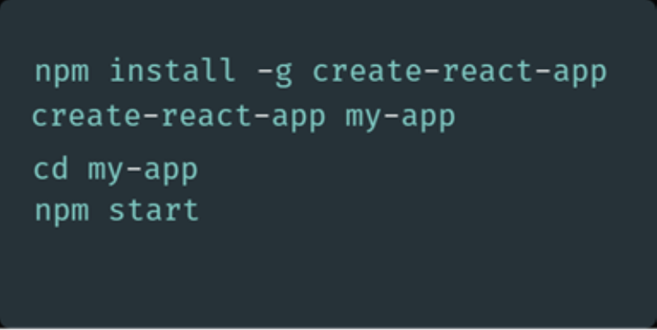
React JS Installation:
Online code playgrounds:
CodePen
CodeSandbox
Glitch
Setup Scenario 1:
Step 1: Download NodeJS
Step 2: Download the ‘create-react-app’ Tool from Git Hub
Step 3: Open cmd prompt and navigate to the project directory
Run app with yarn start command
*If create-react-app hello-react-devbios doesn’t work, try npx create-react-app my-app

Slide 9
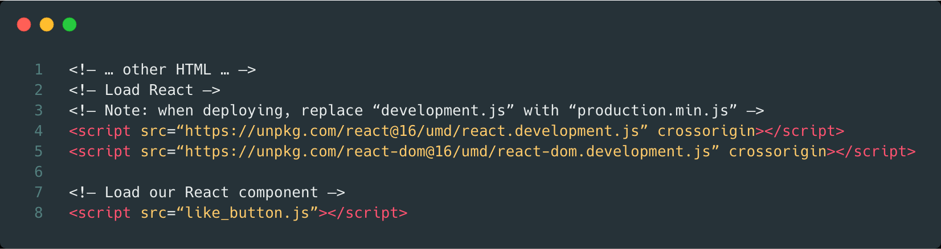
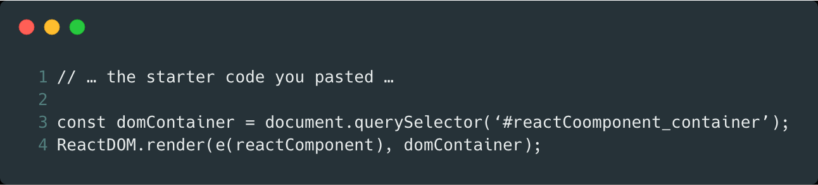
Setup Scenario 2:
Step 1: Add a DOM Container to the HTML
Step 2: Add the Script Tags
Step 3: Create a React Component

Slide 10
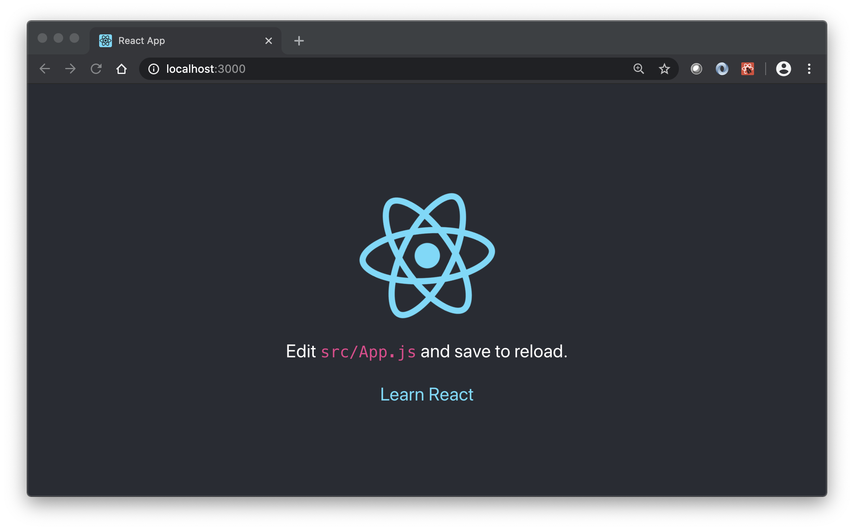
Hello React!

Slide 11
Project Structure

Slide 12
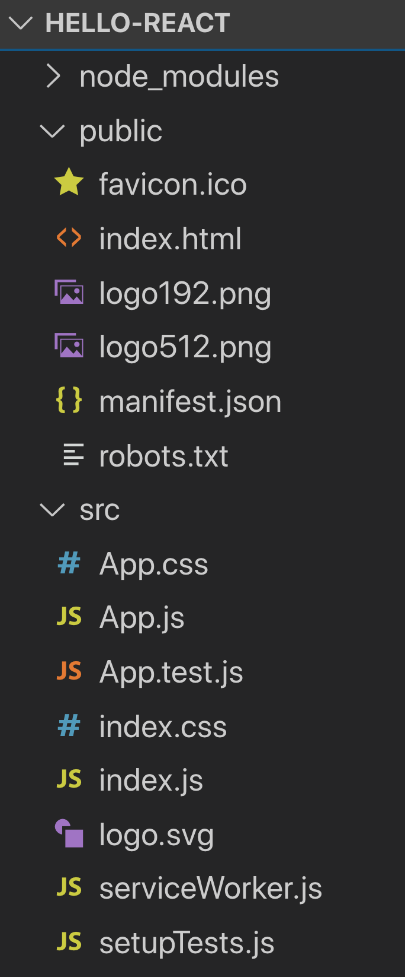
Hello React Project Structure
node_modules – the node.js library
public – location of all root elements
index.html – single page in SPA
manifest.json – W3C spec for browser rendering
Robots.txt – crawler directives https://support.google.com/webmasters/answer/6062608?hl=en
src – contains js source code
App.js – main/first React Component
App.test.js – test file for App.js. All test files should end in .test.js. Yarn test launches jest test runner.
index.js – starting poing for React app. Injects App component into index.html
serviceWorker.js – used for offline functionality. See https://developers.google.com/web/fundamentals/primers/service-workers/

Slide 13
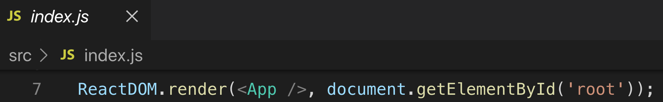
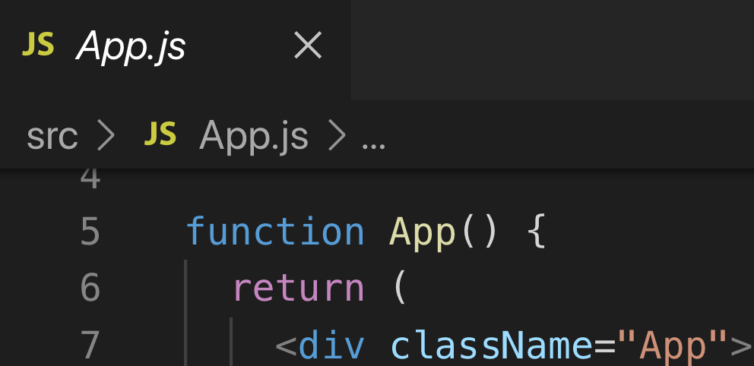
Hello React Project Structure
index.html root element
<App /> element passed to React to render in root
<App /> component defined

Slide 14
Under the React Hood

Slide 15








Who uses React ??

Slide 16
Features of React
Virtual Document Object Model (DOM)
One way data binding
Use of JSX
Composition of Components

Slide 17
What is Virtual DOM ?
Virtual DOM is an in-memory representation of Real DOM. It is a lightweight JavaScript object which is copy of Real DOM.
It has the same properties as a real DOM object, but it lacks the power to directly change what’s on the screen.
Manipulating the DOM is slow. Manipulating the virtual DOM is much faster, because nothing gets drawn onscreen.
DOM
Virtual DOM
Diff
Updated Virtual DOM

Slide 18
How does Virtual DOM work ? – ‘Reconciliation’
Real DOM
The entire virtual DOM gets updated.
The virtual DOM gets compared to what it looked like before you updated it. React figures out which objects have changed using the ‘diff’ algorithm.
Only the changed objects get updated on the real DOM.
Changes on the real DOM cause the screen to change
Model
Patch
Diff
DOM
In-memory DOM

Slide 19
How does Virtual DOM make React faster ?
Efficient diff algorithm
Batched update operations
Efficient update of sub tree only
Uses observable instead of dirty checking to detect change

Slide 20
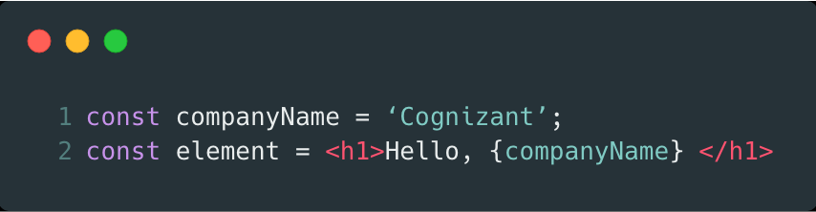
What is JSX ? - JSX produces React “elements”
JSX is an inline markup that looks like HTML and gets transformed to JavaScript and is used to create React elements. These elements are then rendered to the React DOM. A JSX expression starts with an HTML-like open tag, and ends with the corresponding closing tag.

Slide 21
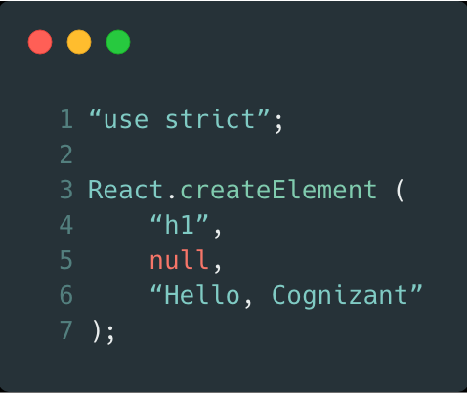
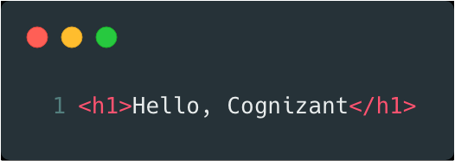
Fundamentally, JSX just provides syntactic sugar for the React.createElement(component, props, ...children) function. Behind the scenes, Babel (preprocessor) transpiles our code into a code which can be recognized by React to create Objects that can be used to construct the DOM

Slide 22
How does JSX benefit ?
It is faster than normal JavaScript as it performs optimizations while translating to regular JavaScript.
It makes easier for us to create templates.
Instead of separating the markup and logic in separated files, React uses components for this purpose. We will learn about components in details in further articles.

Slide 23
One way data binding
React apps are organized as a series of nested components. These components are functional in nature: that is, they receive information through arguments (the props) and pass information via their return values (the return value of the render function).
This is called unidirectional data flow.
Data is passed down from components to their children via props.
Parent
Emit Events
Pass
Props
Child

Slide 24
How does Unidirectional Flow of data benefit ?
Data flows throughout the app in a single direction, hence the developers have a better understanding and control over it.
Data flows in one direction after some change. This makes it easy to identify the source of the change, and then follow that change as it moves through your system.

Slide 25
Composition of Components
Everything in React is a component, and it follows a strong component based model promoting code reuse.
An app composed of many small parts is more manageable than a single large monolith app.
<App />
<MenuBar />
<MainPage />
<ListItem />
<ListItem />
<ListItem />
<SiteFooter />

Slide 26
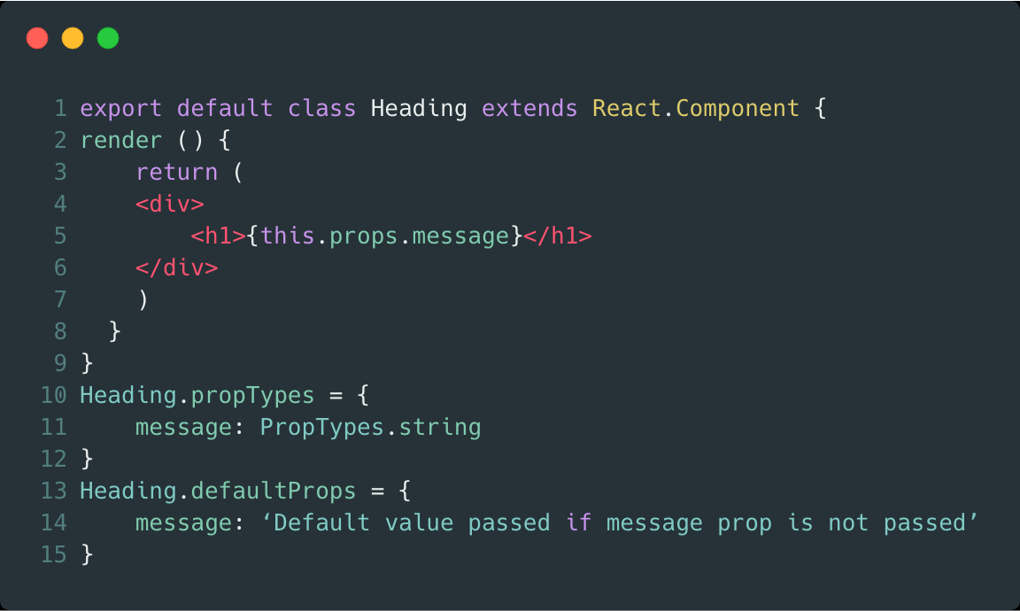
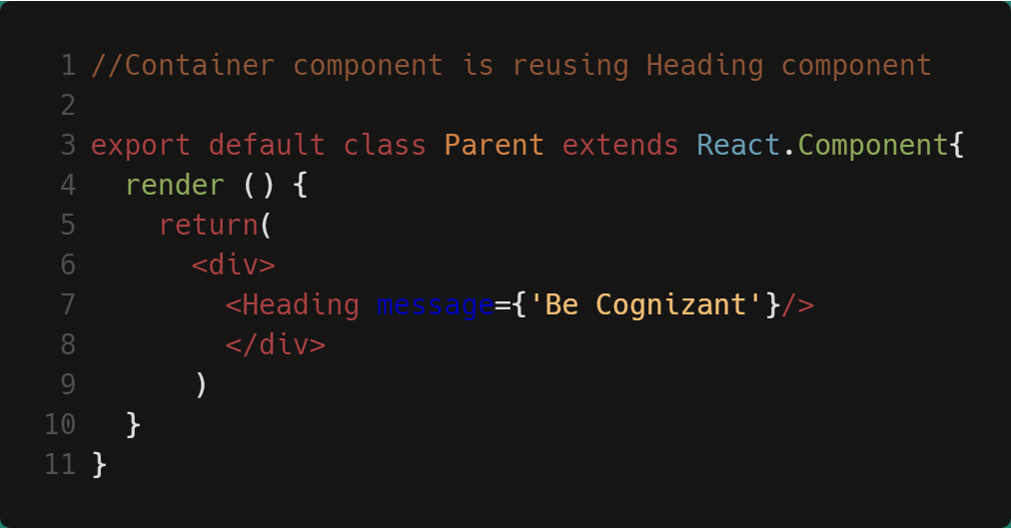
Creating a component
Features of React
Using/Reusing the component
Now Heading component can be used by other components.

Slide 27
Review
Index.html is single page
App is main element inserted into Index.html
App is a React component defined in App.js
Virtual Dom reconciles changes and updates real Dom
Components are the building blocks
JSX used to create templates

Slide 28

Practice Check
What is React JS?
Server side Framework
User-interface framework
A Library for building interaction interfaces
2. What are the advantages of React JS?
React uses a Virtual Dom for fast rendering
Using React increases readability and makes maintainability easier. Component, Data patterns improves readability and thus makes it easier for maintaining larger apps
React uses JSX to improve readability and development of html elements
All of the above

Slide 29
Practice Check
3. What command creates a new React app?
4. What is the first/only React component in the out-of-the-box React app
Index
ServiceWorker
App
Root

Slide 30
What do you think is the most difficult part about React?
What do you think is the most impressive part about React?
What do you think is the simplest part about developing a React app?

Slide 31
Thank You

